Slide 1

Software Construction and Development
COURSE INSTRUCTOR: MUHAMMAD Tauseef

Slide 2
Software Process Model
A software process model is a simplified representation of a software process. Each model represents a process from a specific perspective.

Slide 3
Software Process Model
Waterfall model
V-Model
Incremental Model
Spiral Model
Big Bang Model
Iterative Model and so on…

Slide 4

Question?
Why we need so many models?

Slide 5
Why we need so many models?
There are many development life cycle models that have been developed in order to achieve different required objectives.
The selection of model has very high impact on the testing that is carried out.
It will define the what, where and when of our planned testing, influence
regression testing and largely determines which test techniques to use.
Choosing right model for developing of the software product or application is very important. Based on the model the development and testing processes are carried out.

Slide 6
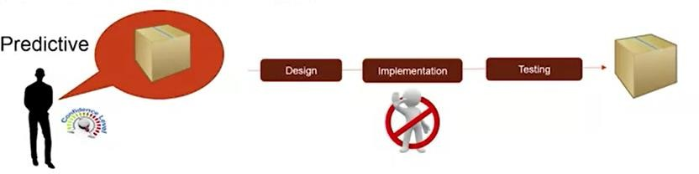
Predictive Approach

Slide 7
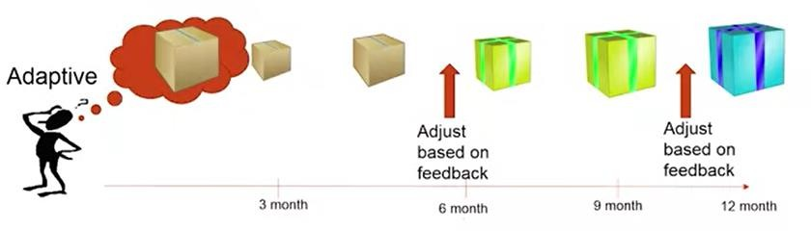
Adaptive Approach

Slide 8
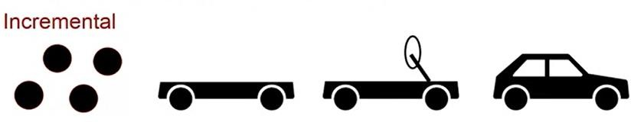
Incremental Approach

Slide 9
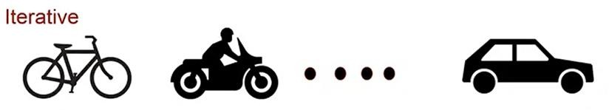
Iterative Approach

Slide 10
Software Process Model

Slide 11
Waterfall Model
The waterfall model is a sequential approach where each phase is arranged in a linear order.
In the waterfall model, you must plan and schedule all of the activities before starting working on them.

Slide 12
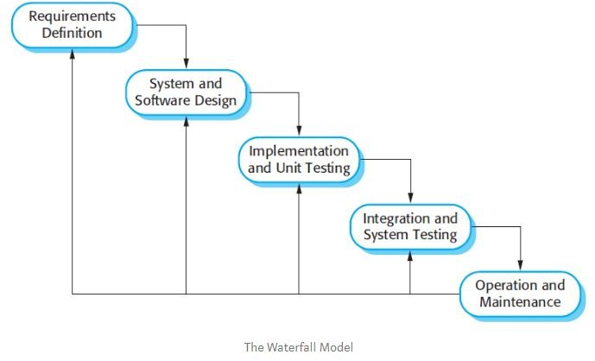
Waterfall Model

Slide 13
When To Use?
This model is used only when the requirements are very well known, clear and fixed.
Team has experience building similar software.
Product definition is stable.
Technology is understood.
There are no ambiguous requirements
The project is short.

Slide 14
Advantages
Simple, Easy to understand.
Predictability.
Efficient.

Slide 15
Disadvantages
Not Flexible to change.
First release takes a long.

Slide 16
V-Model
If you have been in the software industry and you have been using the waterfall method, you must have seen when the time crunch is there in the end. We squeeze the testing phase and try to go through that testing phase as quickly as possible because the deadline is looming and we need to deploy the software.
V-model, it looks very similar to the waterfall method, but it's just bent into a
shape of a V.
But if you look closely, the left side of the model is about the product definition, where it's getting finer and finer. So from the concept, you go to the requirement, and to the design, and to the implementation. And then the right side is showing all the validation steps that are corresponding to the steps on the left.

Slide 17
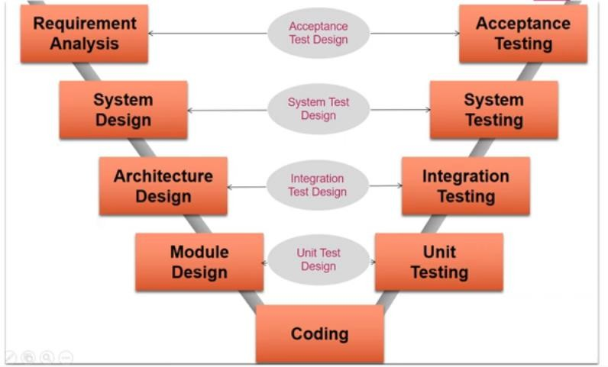
V-Model

Slide 18
Verification and Validation
Verification: Are we building the product right?
Validation: Are we building the right product?

Slide 19
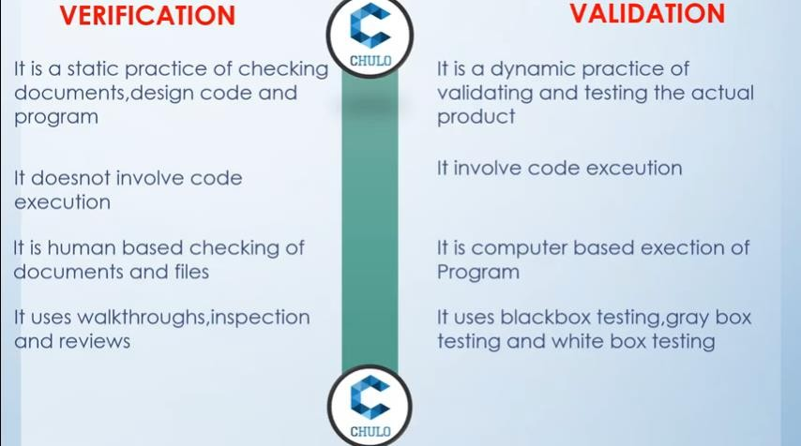
Verification and Validation

Slide 20
Verification
To check whether software meets specifications. Activities involved in verification:
1.Inspections 2.Reviews
3.Walkthroughs 4.Desk-checking

Slide 21
Validation
To check if the software meets customer’s expectations
Activities involved in validation: 1.Black box testing
White box testing
Unit testing 4.Integration testing

Slide 22
When Use V-Model
This model can be used when the requirements of the complete system are clearly defined and understood.
If there is ambiguity in the requirements, and then you want some kind of early validation, would help, then you can use V-model.
The V-Shaped model should be chosen when ample technical resources are available with needed technical expertise.

Slide 23
Advantages and Disadvantages
Advantages of V-model:
Simple and easy to use.
Testing activities like planning, test designing happens well before coding. This saves a lot of time. Hence higher chance of success over the waterfall model.
Proactive defect tracking – that is defects are found at early stage.
Avoids the downward flow of the defects.
Disadvantages of V-model:
Very rigid and least flexible.
Software is developed during the implementation phase, so no early prototypes of the software are
produced.
If any changes happen in midway, then the test documents along with requirement documents has to be updated.

Slide 24
Incremental Model
Build system in increments by dividing the whole system in modules.
Each increment follow a model, normally it’s a water fall model but
you can use the variety of model in each increment.
May overlap the increments.
There are many variations in incremental model.

Slide 25
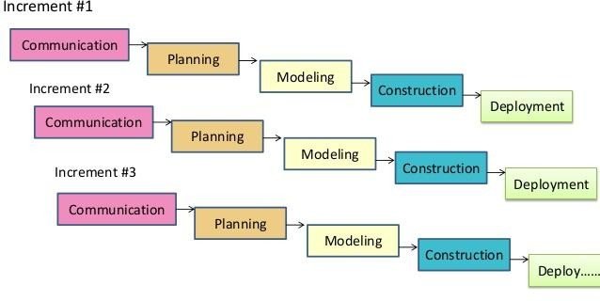
Incremental Model

Slide 26
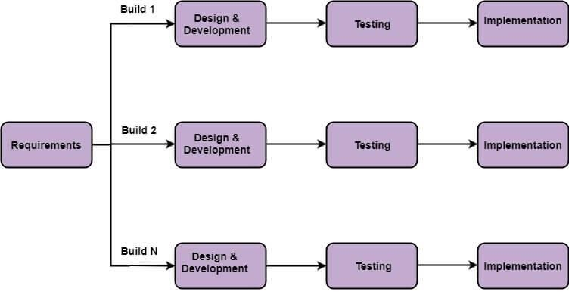
Incremental Model (Variation)
© Saif ul Islam -
2020

Slide 27
When to use ?
This model can be used when the requirements of the complete system are clearly defined and understood.
Major requirements must be defined; however, some details can evolve with time.
There is a need to get a product to the market early.

Slide 28
Advantages
Delivery value earlier.
It is easier to test and debug during a smaller iteration.
In this model customer can respond to each built.
Get Feedback and make necessary changes between increments.

Slide 29
Disadvantages
Needs good planning and design.
Needs a clear and complete definition of the whole system before it can be broken down and built incrementally.
Total cost is higher than waterfall.

Slide 30



Predictive or Adaptive
Water Fall Model
V-Model
Incremental Model

Slide 31
Scenarios
MAJU KARACHI – SOFTWARE CONSTRUCTION AND DEVELOPMENT

Slide 32
Scenario 1
XYZ company want a software for their inventory management and day to day procurement and reporting. Your team has gathered their requirements and clearly understood them. The team that will be working on the project will be competitive and have ample experience in building the similar systems. Cost of the project is medium to high as the team is composed of experts which are required to pay good amount. Project is sort of operational so it demands no malfunctioning and data loss. Project is not a huge one and company is not in a hurry for early deployment. What model do you adopt for building this project and why?

Slide 33
Spiral Model
The spiral model is similar to the incremental model, with more emphasis placed on risk analysis. The spiral model has four phases: Planning, Risk Analysis, Engineering and Evaluation. A software project repeatedly passes through these phases in iterations (called Spirals in this model).

Slide 34
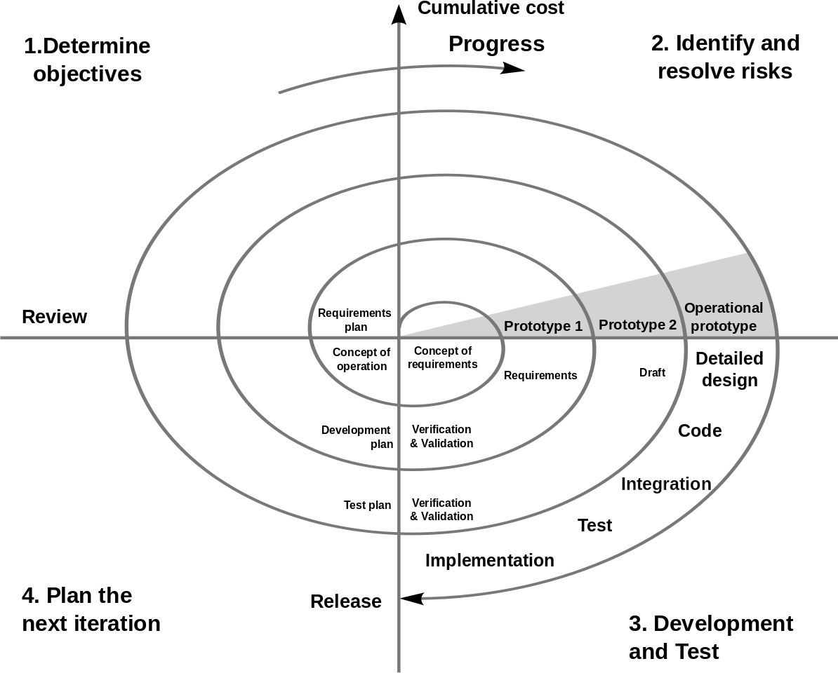
Spiral Model

Slide 35
Four Phases of Spiral Model
Objectives and Constraints: Define what exactly would be the objective for this cycle. And then you have to talk to all of your stakeholders so that it meets the need of all the stakeholders. And, at the same time, you define what are the constraints to achieve those objectives in that cycle. And find alternative solutions.
Identifying and resolving risk: It is not just only about identify the risk, but then find ways to mitigate or do something about those risks. So sometimes you might be building a prototype, or you might be doing some surveys or whatever you need to do, or some research to identify what other things can go wrong and then you try to resolve what you can.

Slide 36
Four Phases of Spiral Model
Development and Testing : If you are doing feasibility study then you do your feasibility study, or if you're doing requirements, then you write those and so on. And if you're doing actual development then you go through the design code integration and the result. So whatever is the objective of that cycle, the work needed to be done to achieve that objective is done here.
Review and Plan for Next: The last is to plan the next iteration. So this is the step where you review the work done in this cycle and then, you say, should we continue or should we not continue. And If you will continue then you will decide the goal for next iteration.

Slide 37
When to Use?
When costs and risk evaluation is important
For medium to high-risk projects
Long-term project commitment unwise because of potential changes to economic priorities
Users are unsure of their needs
Requirements are complex

Slide 38
Advantages
High amount of risk analysis hence, avoidance of Risk is enhanced.
Good for large and mission-critical projects.
Strong approval and documentation control.
Additional Functionality can be added at a later date.

Slide 39
Disadvantages
Can be a costly model to use.
Risk analysis requires highly specific expertise.
Project’s success is highly dependent on the risk analysis phase.
Doesn’t work well for smaller projects.

Slide 40
Iterative Model
An iterative life cycle model does not attempt to start with a full specification of requirements. Instead, development begins by specifying and implementing just part of the software, which can then be reviewed in order to identify further requirements. This process is then repeated, producing a new version of the software for each cycle of the model.

Slide 41

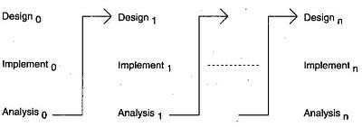
Iterative Model

Slide 42
When to Use?
Requirements of the complete system are clearly defined and understood.
Major requirements must be defined; however, some details can evolve with time.
When the project is big.

Slide 43
Advantages
In iterative model we can only create a high-level design of the application before we actually begin to build the product and define the design solution for the entire product. Later on we can design and built a skeleton version of that, and then evolved the design based on what had been built.
In iterative model we are building and improving the product step by step. Hence we can track the defects at early stages. This avoids the downward flow of the defects.
In iterative model we can get the reliable user feedback.

Slide 44
Disadvantages
Each phase of an iteration is rigid with no overlaps
Costly system architecture or design issues may arise because not all requirements are gathered up front for the entire lifecycle

Slide 45
Scenario 2
Defense organization of a country did a recent study, and the research recommends new capability the country should build to keep the country protected from potential conflicts in the region. So there's a study and the solution, the system that they came up with require to be build has never been attempted, and no literature exist for such system. So it's a very fairly new area, or fairly new adventure or things that they need to create. And it's fairly big and complex system, and potentially can take decades to build. A lot of loss of time, a lot of years to build this software. And scientists have vague idea about how to go about it, but no concrete plan exists. And there'll be a lot of organization stakeholders because this of course defense organization of the country and a lot of stakeholders involved. So a lot of constraints will also be there that will impact on this initiative. So there's a lot of risk, a lot of constraints. So let's try to analyze this situation and see which model will work in this situation.

Slide 46
Solution?
Unknown need and outcomes.
Very Risky.
Very Large and Complex Project.
Which Model/s is/are suitable?
© Saif ul Islam - 2020

